Slide 1
Enhancing E-Commerce Agility With Advanced ETL Pipeline
Presented by
Priya E-ME30

Slide 2
Technologies
*S3
*AWS Glue
*RDS

Slide 3
Problem Statement:
As a Data Engineer Your objective is to build an end-to-end automated data processing workflow that handles data uploads from the Order and Returns teams, performs a join operation using Glue & PySpark, stores the joined data in Redshift, and sends notifications about the pipeline's status using SNS.

Slide 4
Creating an S3 Bucket via AWS Management Console
Step 1: Sign in to the AWS Management Console
Go to the AWS Management Console.
Sign in with your AWS credentials.
Step 2: Open the Amazon S3 Console
In the search bar at the top, type S3 and select S3 from the dropdown.
This will take you to the Amazon S3 dashboard.
Step 3: Create a New S3 Bucket
Click the Create bucket button at the top-right corner.

Slide 5
Step 4: Configure Bucket Settings
You will see a form to configure your S3 bucket:
Bucket Name: Enter a globally unique name for your bucket (e.g., my-unique-bucket-name). The name must be globally unique across all AWS accounts.
AWS Region: Choose the AWS region where you want to create the bucket (e.g., us-east-1, us-west-2). It's a good practice to choose a region closest to where you or your users are located to minimize latency.
Step 5: Review and Create the Bucket
Review your settings to make sure everything is correct.
Click Create bucket.
Step 6: Your Bucket is Ready
You will be redirected to the S3 dashboard, where you can see your newly created bucket.
You can now upload files, configure permissions, or enable additional features (like static website hosting).

Slide 6
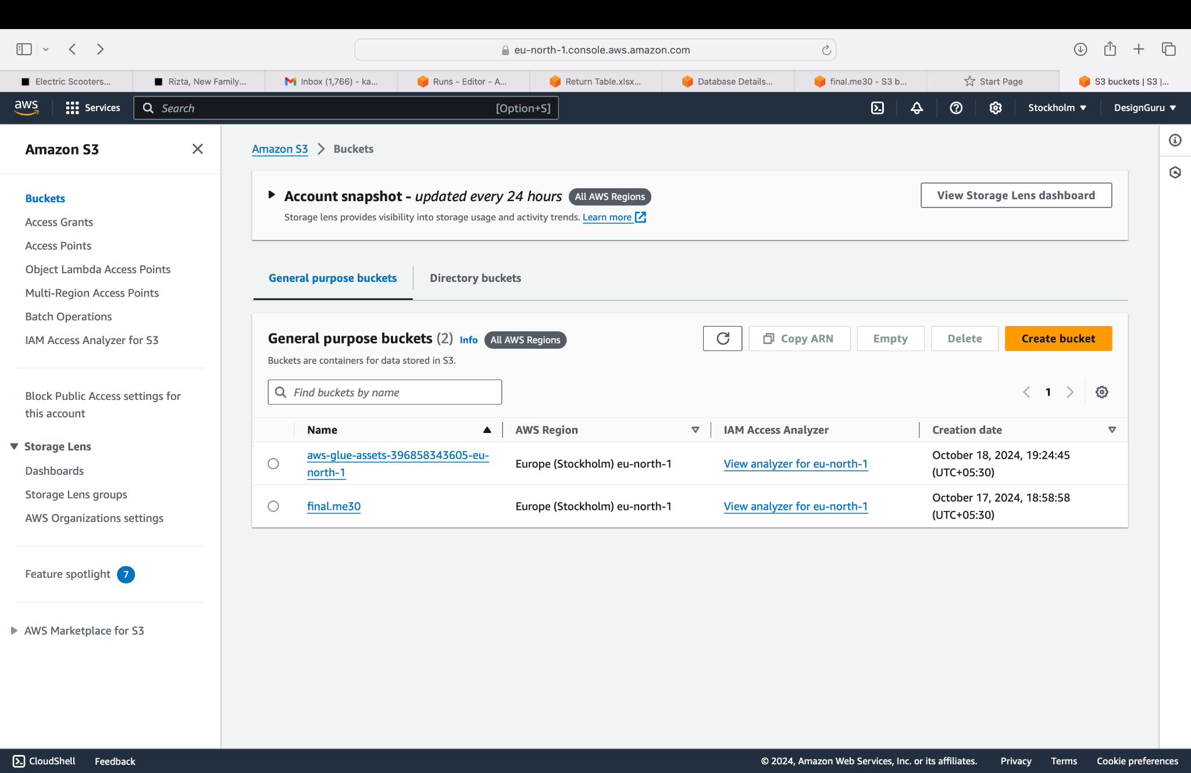

Slide 7
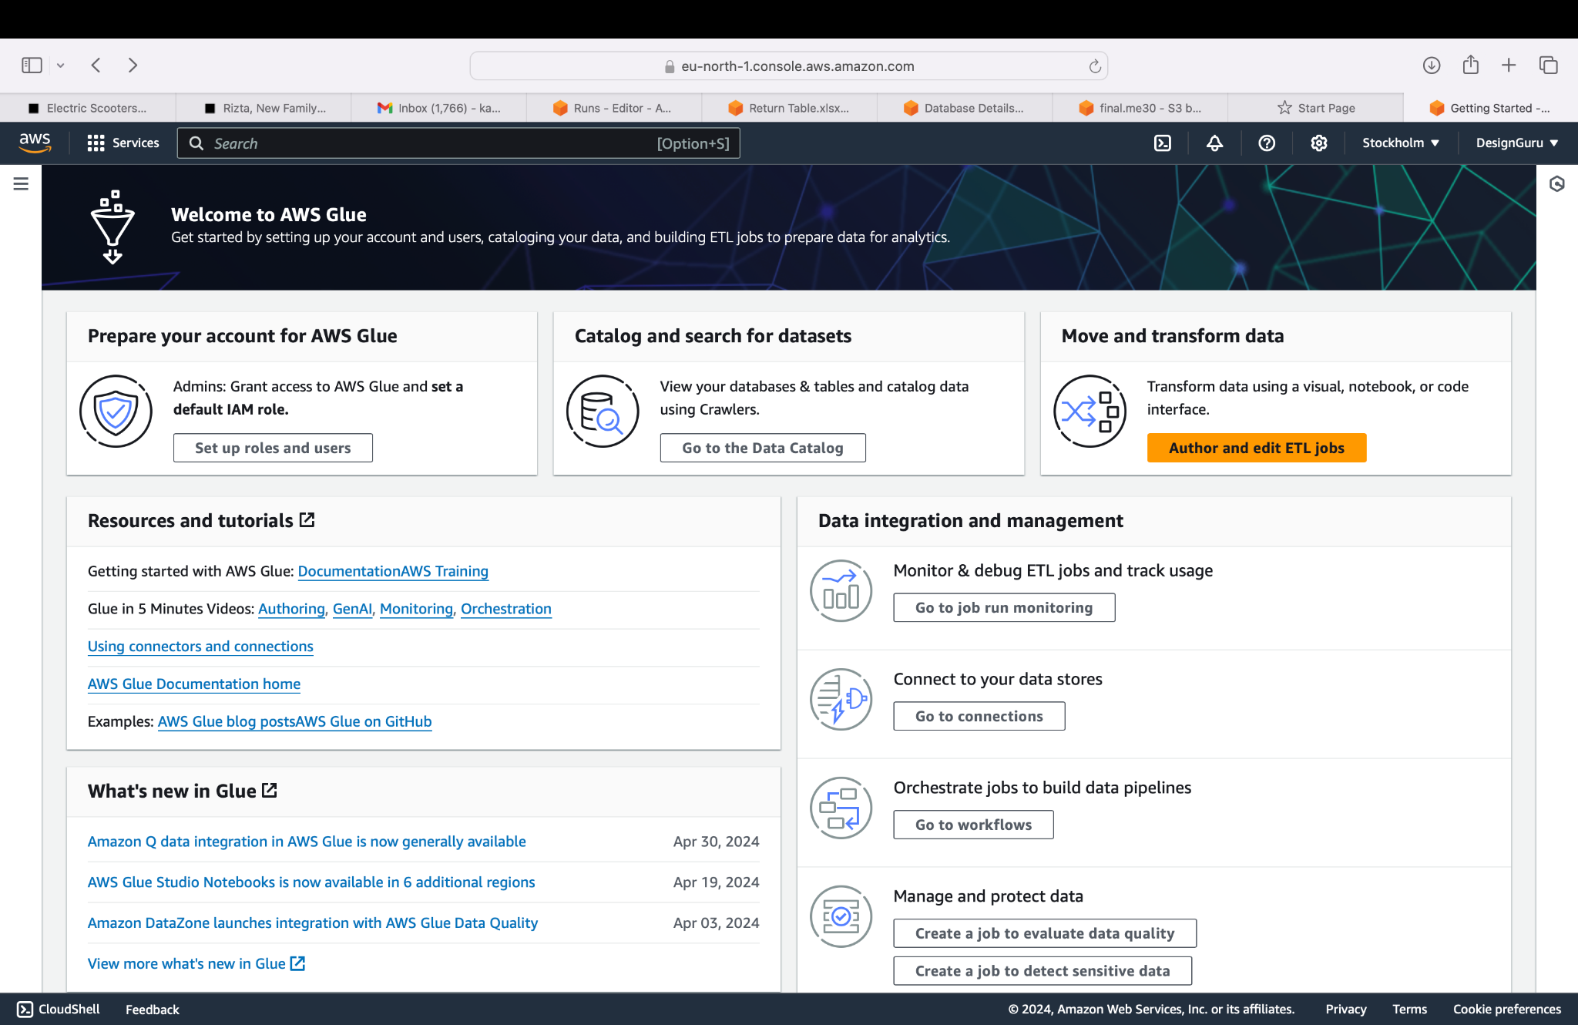
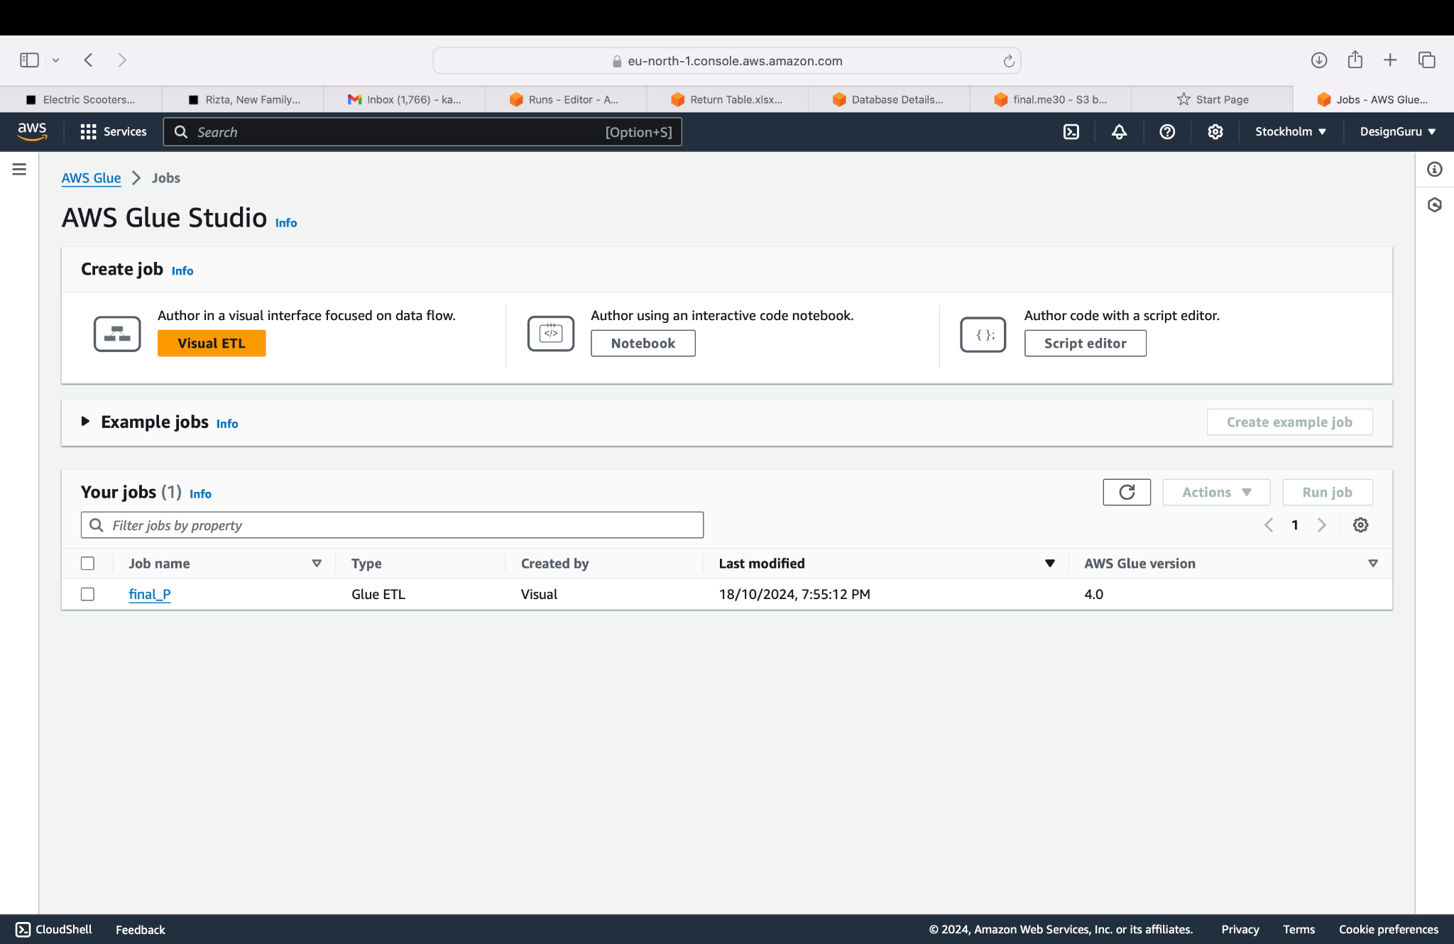
AWS Glue:Creating a visual ETL (Extract, Transform, Load) process in AWS Glue can be done using AWS Glue Studio, a graphical interface that simplifies building, running, and managing ETL jobs without writing complex code. With Glue Studio, you can visually design your ETL pipelines by dragging and dropping components and configuring transformations.

Slide 8
1. Sign in to AWS Management Console
Open the AWS Management Console and sign in with your credentials.
2. Open AWS Glue Studio
In the search bar at the top of the console, type Glue Studio and select it from the dropdown.
This will take you to the AWS Glue Studio dashboard.
3. Create a New ETL Job
From the AWS Glue Studio dashboard, click on the Jobs tab in the left panel.
Click on Create job to start building a new ETL job.
4. Choose the Job Type
Select Visual with a source and target. This option allows you to visually create the ETL pipeline using the drag-and-drop interface.
5. Configure Job Properties
In this step, you’ll configure the basic settings of your ETL job.
Name: Provide a name for your job (e.g., MyVisualETLJob).
IAM Role: Choose or create an IAM role with the required permissions to access AWS Glue, S3, and other services you’ll be interacting with. You can create a new role if you don’t have one by clicking on Create IAM Role.
6. D

Slide 9
6.Define the Source
In the visual editor, click on Choose source.
Select the source type from where you will extract data. AWS Glue supports various sources like Amazon S3, Amazon RDS, Redshift, and other JDBC sources.
For example, to extract data from Amazon S3:
Choose S3 as the data source.
Specify the S3 bucket and prefix where your data is located (e.g., s3://my-bucket/input-data/).
If your data is in CSV, Parquet, or other formats, select the appropriate format and define the schema or let Glue infer the schema.
7. Add Transformations
After defining the source, you can add transformations. In the visual editor, click on the plus (+) icon to add transformations such as:
Mapping: To map or rename columns from the source to the target.
Filter: To filter rows based on certain conditions.
Join: To join data from multiple data sources.
Aggregate: To perform aggregation like sum, average, count, etc.
ApplyMapping: To apply specific column data types for transformation.
Example: To filter out rows where a column value is less than a certain number, you can add a Filter transformation and specify the filtering condition.

Slide 10
8. Define the Target
After adding transformations, you’ll need to define the target where you will load the transformed data.
Click on Choose target, and select the destination type. You can choose between S3, Redshift, RDS, JDBC, or other targets.
For example, to load data into Amazon S3:
Select S3 as the destination.
Specify the S3 bucket and the path where the transformed data should be saved (e.g., s3://my-bucket/output-data/).
Define the output format (e.g., CSV, Parquet, JSON).
9. Configure Job Options
Job Bookmarking (Optional): If you're dealing with large datasets and only want to process new or changed data in subsequent runs, enable job bookmarking.
Concurrency (Optional): You can configure the number of job runs in parallel.
Worker Type: Select the type of worker to use for the job. Choose between Standard, G.1X, or G.2X based on the job’s memory and processing requirements.
Number of Workers: Configure the number of workers to use for the job. Start with 2 or 3 for small jobs and increase as necessary.

Slide 11
10. Save and Run the Job
Click Save to save your ETL job.
Click Run to execute the job. AWS Glue will extract data from the source, apply transformations, and load the results into the target destination.
11. Monitor the Job
You can monitor the job’s progress in the AWS Glue Studio dashboard.
The Run Status section shows the job status (e.g., running, completed, or failed). You can also view logs for the job via Amazon CloudWatch to troubleshoot any issues.

Slide 12
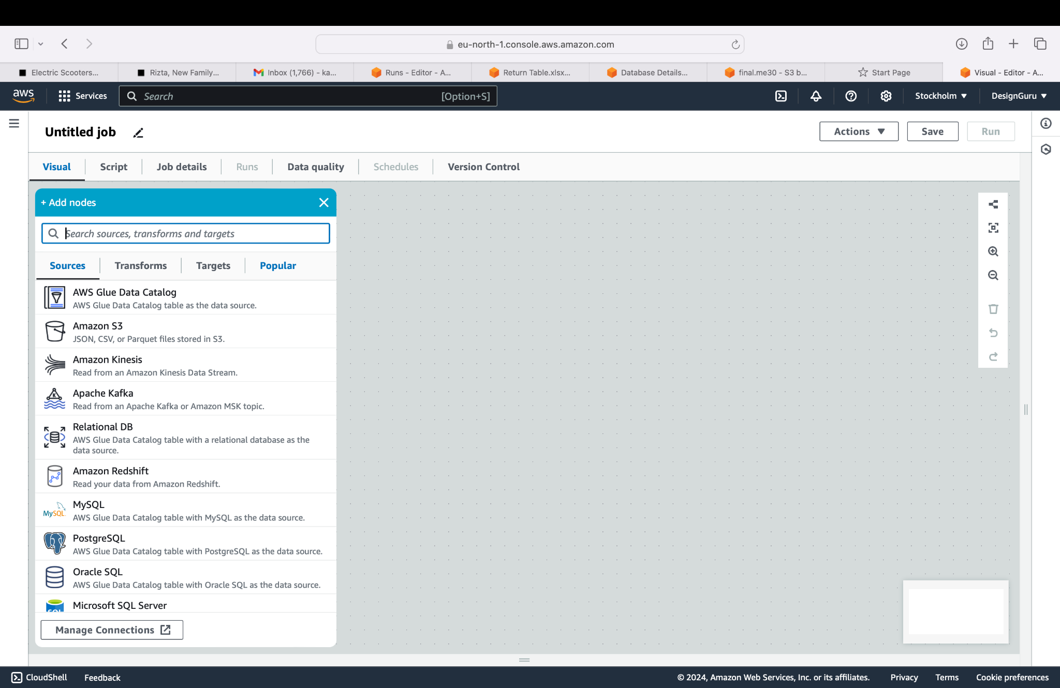
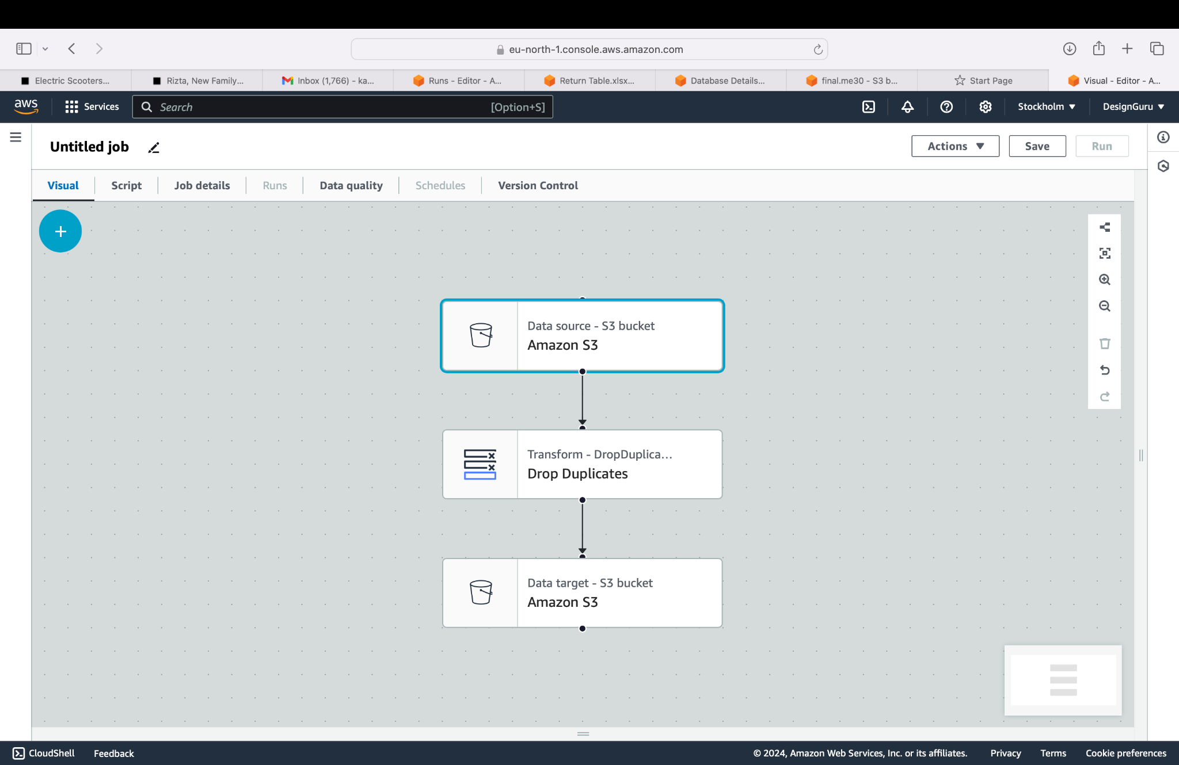

Slide 13
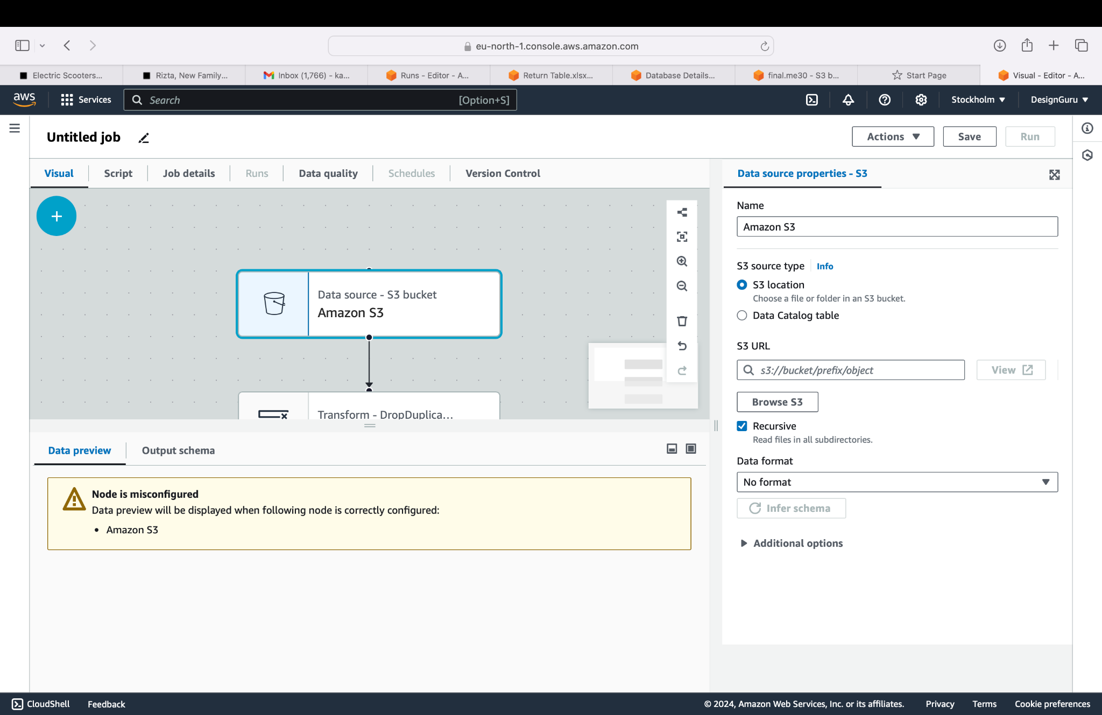
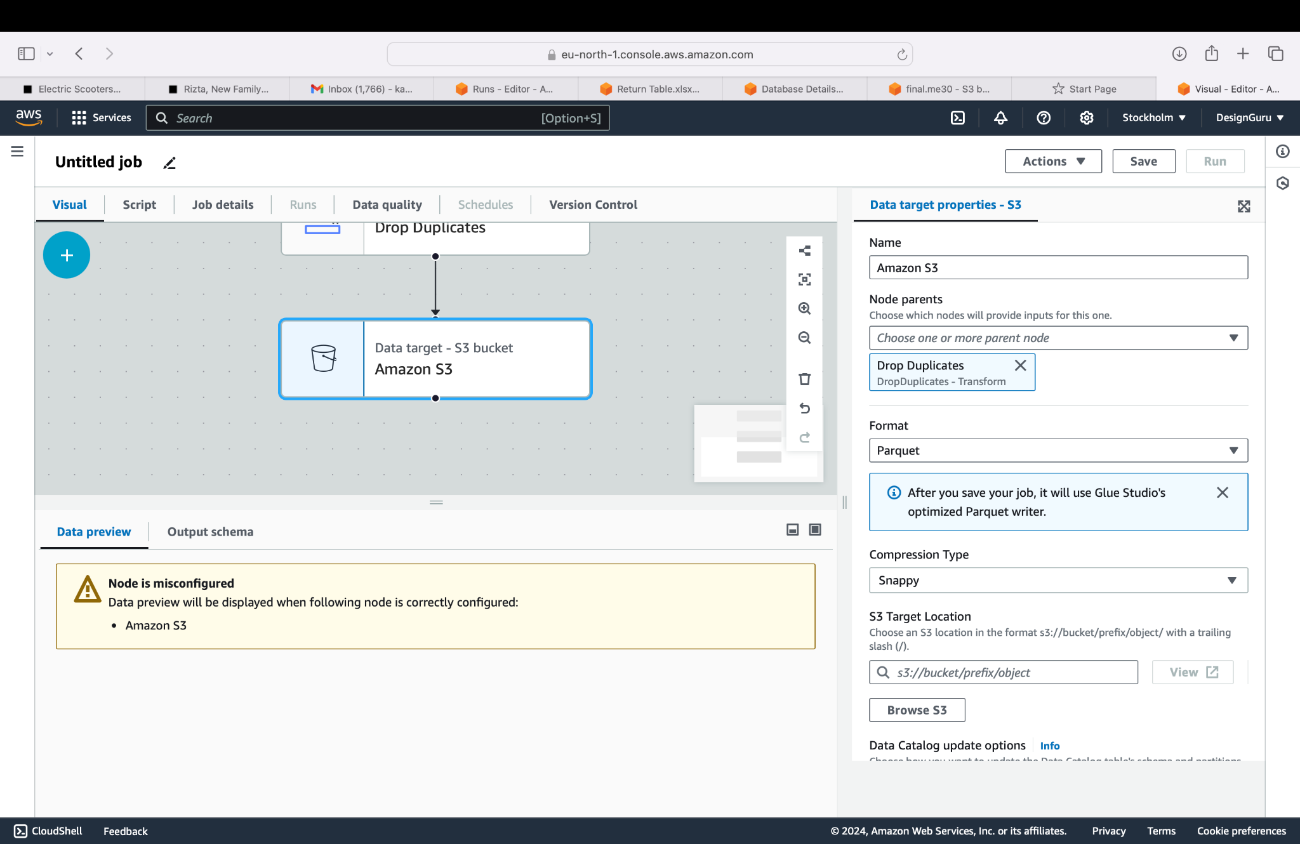

Slide 14
CREATING AN RDS DATABASE VIA AWS MANAGEMENT CONSOLE
Step 1: Sign in to AWS Management Console
Go to the AWS Management Console.
Log in with your credentials.
Step 2: Open the RDS Console
In the search bar at the top, type RDS and select Amazon RDS from the dropdown.
This will take you to the Amazon RDS dashboard.
Step 3: Create a New Database
In the RDS dashboard, click on the Databases tab in the left-hand panel.
Click on the Create database button.
Step 4: Choose a Database Creation Method
Standard Create: Gives you more control and customization options, including the instance type, network settings, and storage options.
Easy Create: A simplified process with fewer configuration options (for basic setups).
For more customization, choose Standard Create.

Slide 15
Step 5: Choose a Database Engine
Select the type of database engine you want to use:
Amazon Aurora (MySQL-compatible or PostgreSQL-compatible)
MySQL
PostgreSQL
MariaDB
Oracle
Microsoft SQL Server
Example: If you want to use MySQL, select MySQL as the engine.
Step 6: Specify Version and Templates
Version: Choose the version of the database engine you want to use (e.g., MySQL 8.0, PostgreSQL 13).
Templates:
Production: For workloads requiring high availability and backups (includes Multi-AZ deployment and backups).
Dev/Test: For development or testing purposes (not as resilient as production).
Free Tier: For those using the free-tier option (good for light workloads).
Example: Select Free tier if you are eligible and prefer a low-cost option.
Step 7: Configure the Database Settings
DB Instance Identifier: Enter a unique name for your database instance (e.g., mydb-instance).
Master Username: Choose a master username (e.g., admin).
Master Password: Enter and confirm the master password.

Slide 16
Step 8: Configure Instance Specifications
DB Instance Class: Choose the instance type based on your use case. For free tier, you can select db.t2.micro or db.t3.micro.
Storage Type: Choose the storage type. Options include General Purpose (SSD), Provisioned IOPS (SSD), or Magnetic (not recommended for production).
Allocated Storage: Specify the amount of storage (minimum 20 GB for free tier).
Step 9: Configure Availability and Durability (Optional)
Multi-AZ Deployment: Enable this for production environments to provide high availability by creating a standby replica in a different availability zone. This is optional and adds redundancy.
Step 10: Configure Connectivity
Virtual Private Cloud (VPC): Select the VPC where your database will be deployed. If you don't have one, AWS will create a default VPC.
Subnet Group: Choose a subnet group for your database.
Public Access: Choose whether you want the database to be publicly accessible. If your database needs to be accessed from outside the VPC, enable public access. For security reasons, it is generally recommended to set this to No unless necessary.
VPC Security Group: Select or create a security group to control access to your database.

Slide 17
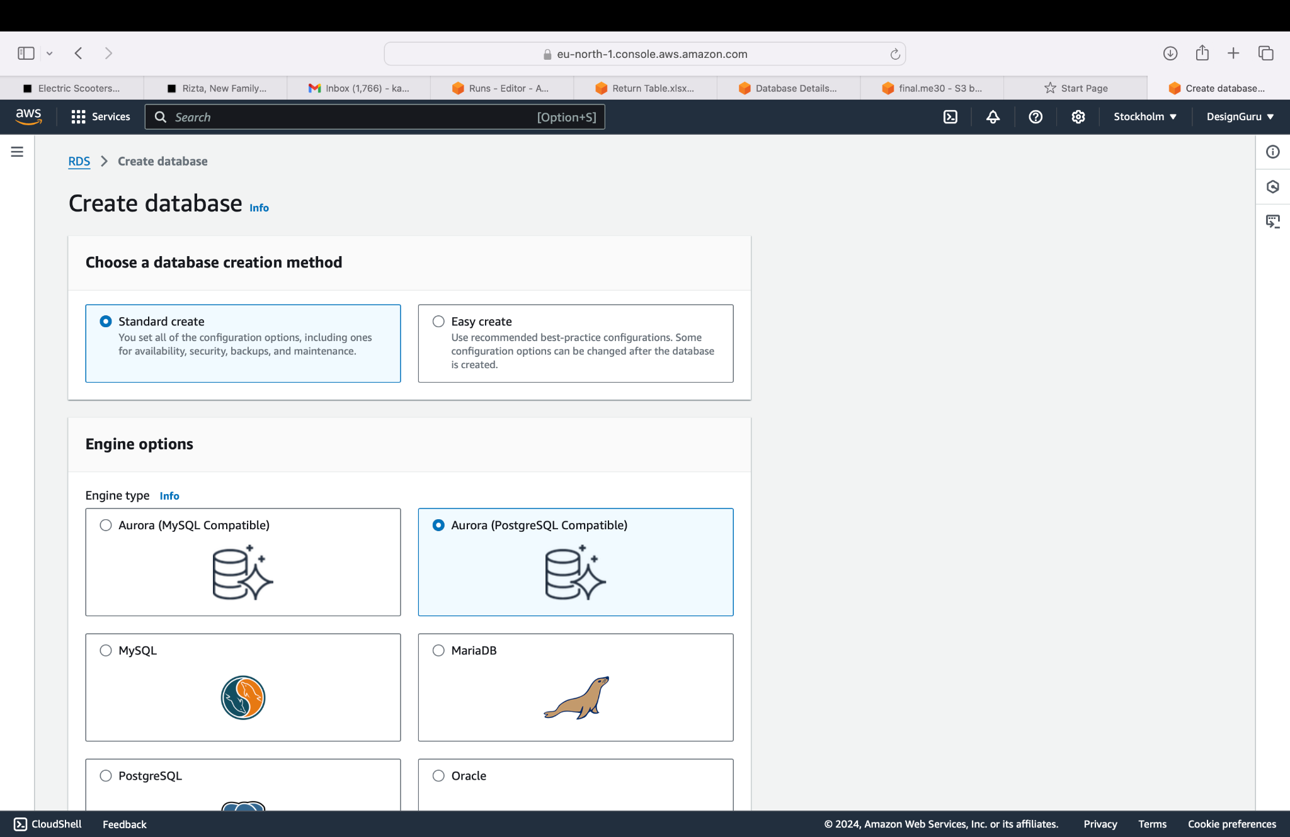
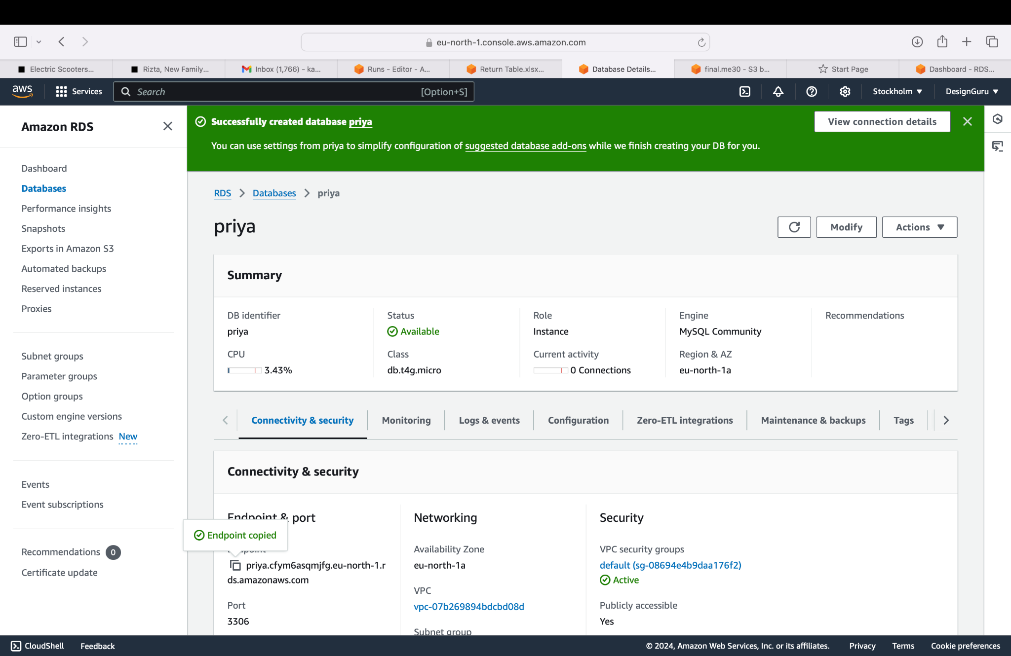

Slide 18
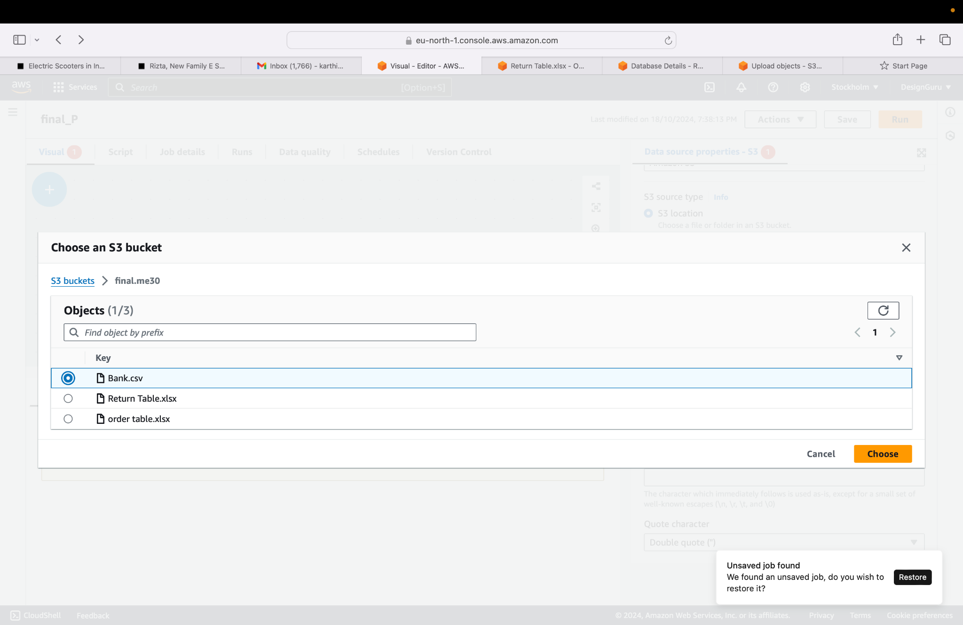
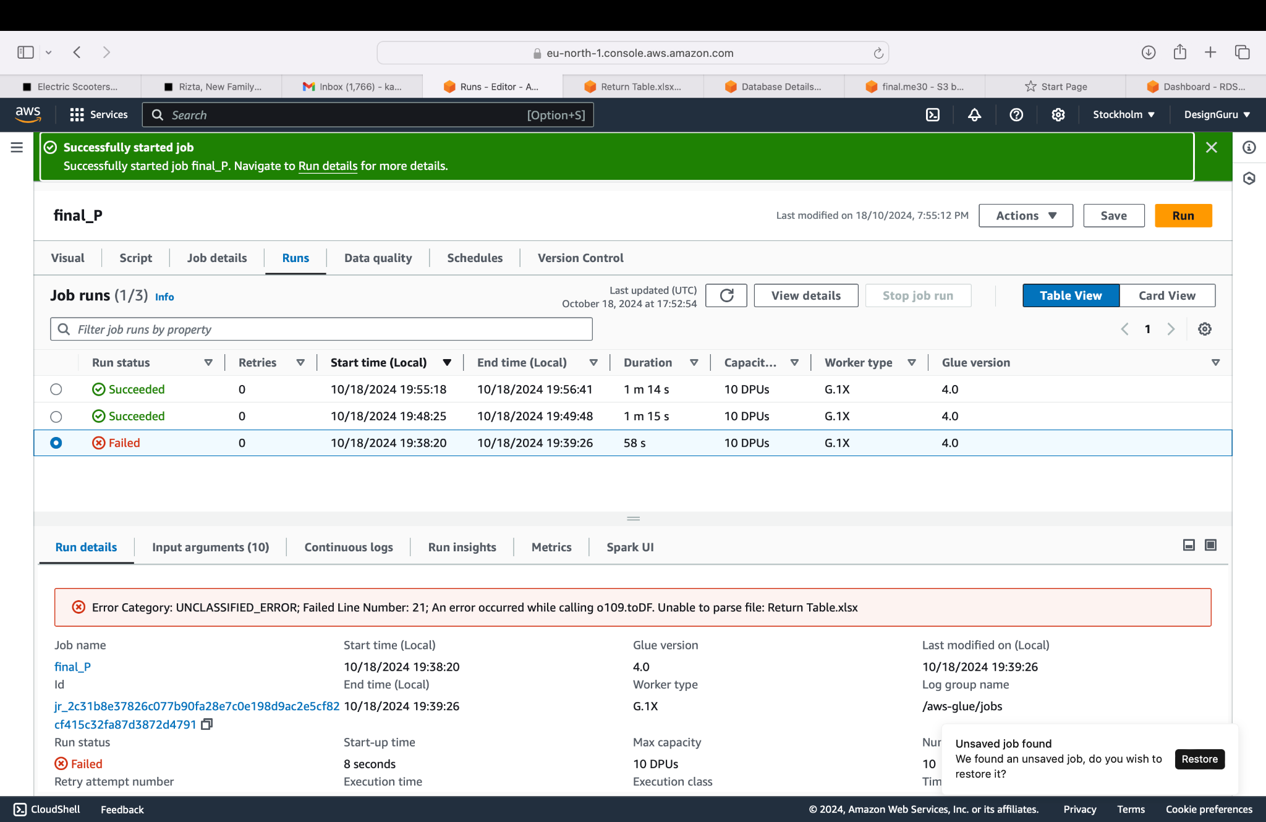

Slide 19
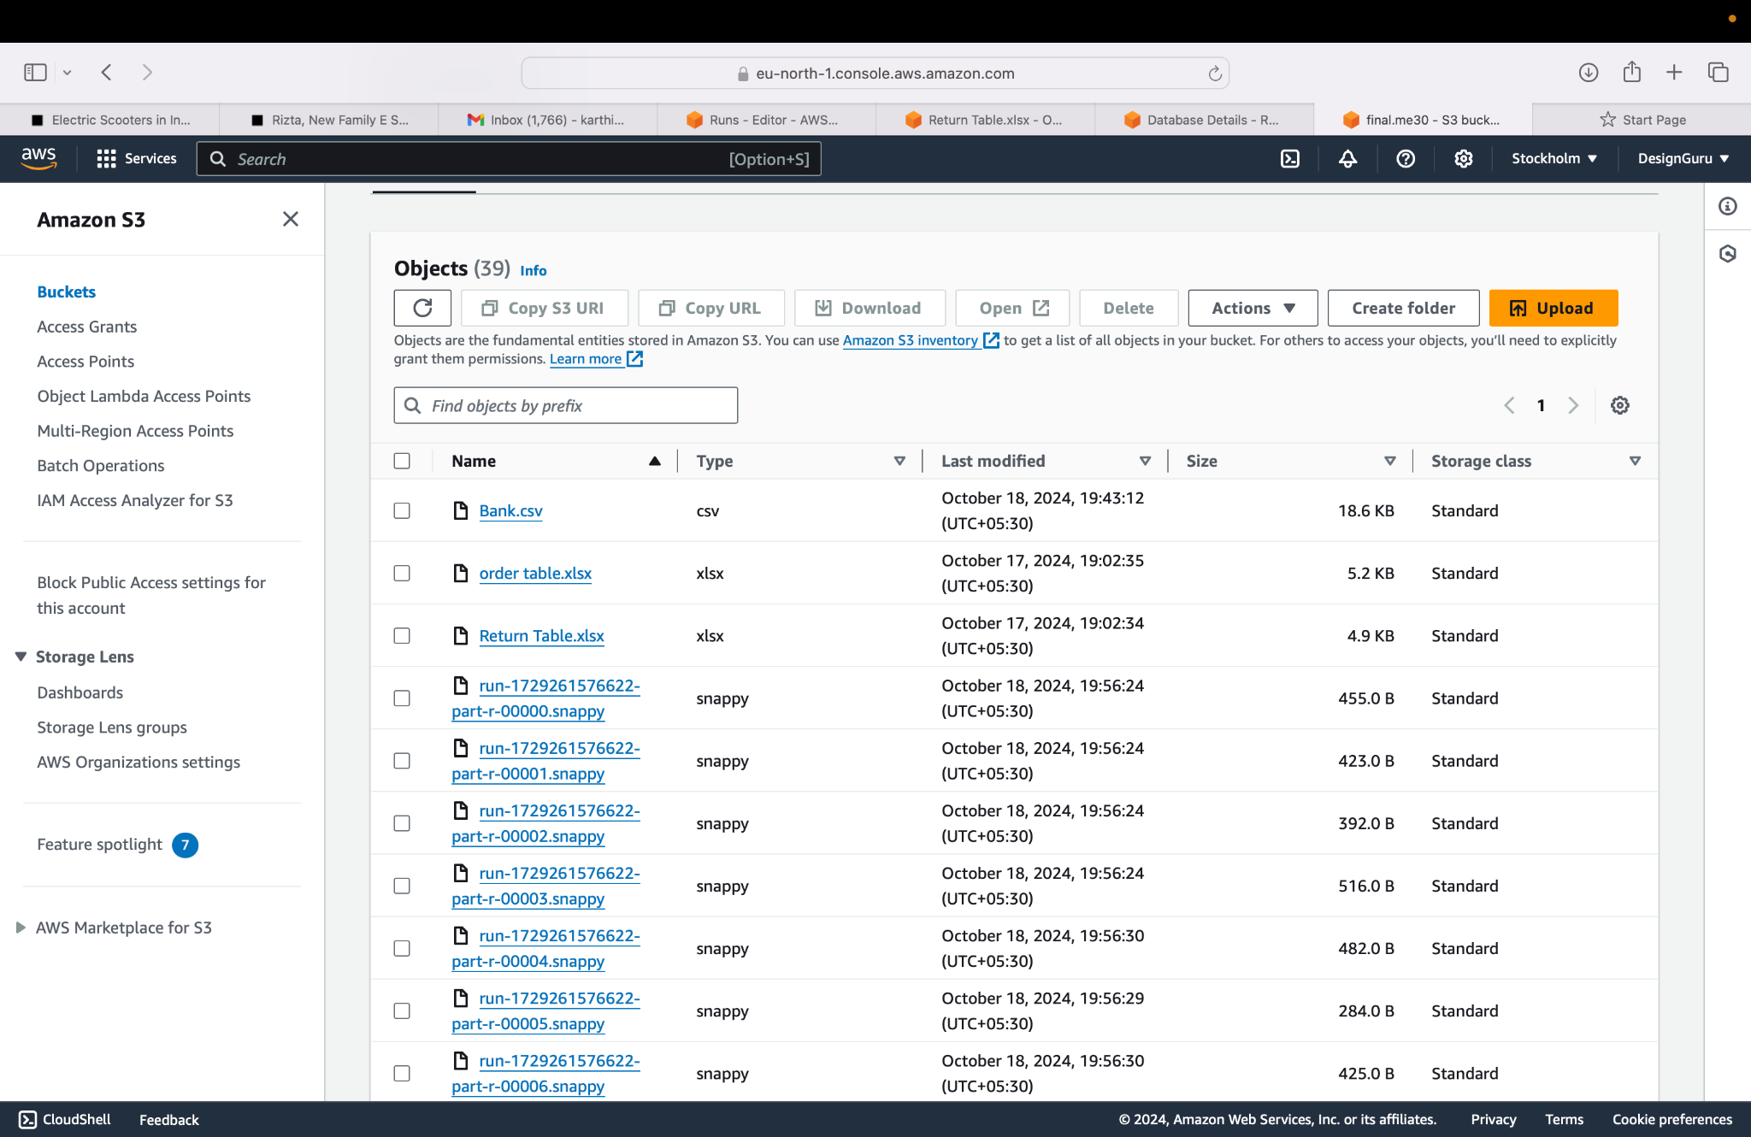

Slide 20
THANK YOU

